Slide 1
Insect recognition based on complementary features from multiple views
Authors:
Jingmin An
Yong Du
Peng Hong
Lei Zhang
Xiaogang Weng

Slide 2
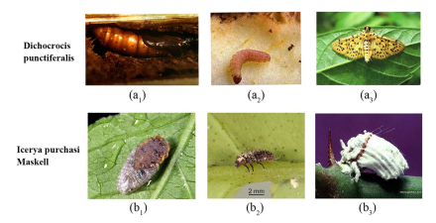
Introduction
Significance of Insect Pest Recognition
Challenges in Human Expert Recognition
Importance of Machine Learning in Insect Recognition

Slide 3
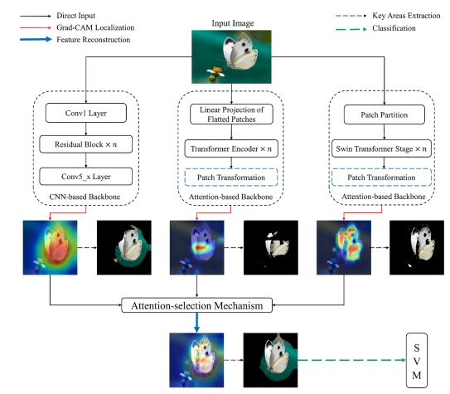
Proposed Methodology
Feature Fusion Network for Synthesizing Features
Use of ResNet, Vision Transformer(ViT) and Swin Transformer
Grad-CAM for Localizing Important Regions
Attention-Selection Mechanism for Feature Reconstruction

Slide 4
Attention-Selection Mechanism
Comparison of CNN-Based ResNet152 and Attention-Based Vision Transformer (ViT) and Swin Transformer
Modifications for Applying Grad-CAM to ViT and Swin-T
Experimentation
Dataset : IP102 - A Challenging Dataset
Evaluation Metrics: F1, Recall, Precision,Accuracy
Comparison with CNN-Based Models

Slide 5
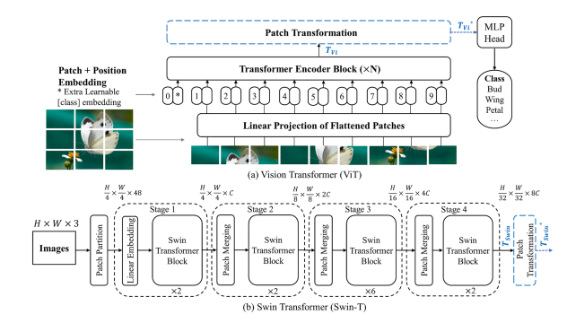
Data Augmentation
Random Adoption of Seven Augmentation Methods
Impact on Attention Information in Different Backbones
Stability Improvement through Attention-Selection
Classification Result
Performance Using Single-Attention Information
Impact of Attention-Selection Mechanism on Recognition

Slide 6
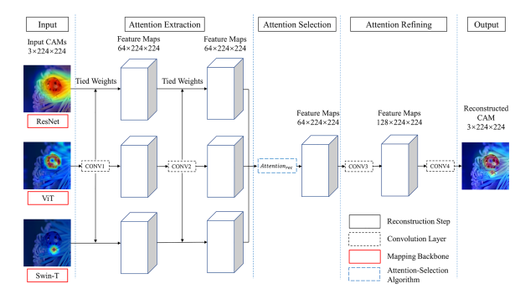
Training time
Comparison of Training Time with State-of-the-Art Models
Efficiency and quick Application of Attention-Selection
Discussion
Handling Unbalanced Dataset and Growth Stage Variance
Robustness of Attention-Selection Mechanism
Potential for Generalization to Other Recognition tasks

Slide 7
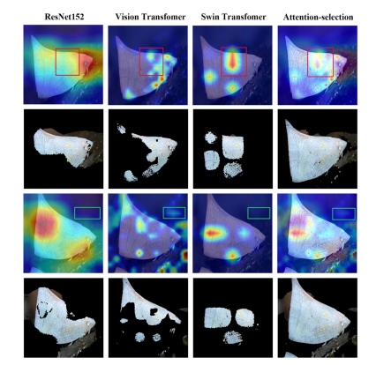
Conclusion
Summary of Contributions
Strong Classification on IP102 Dataset
Applicability Beyond Insect Recognition

Slide 8
Thank You !

